Slide 1

CCDPH Epidemiology Unit Current Projects
C Scott Smith PhD, AICP
Epidemiologist IV
(last updated 5/19/2022)
Notes:
This project lists the

Slide 2
current projects
CCDPH’s Epidemiology Unit is presently engaged in different types of projects with different groups of partners and sources of funding and timelines for completion. The graphic below summarizes these projects by category.
CDC HEALTH EQUITY Grant
CSTE
ASTHO
SUHI
CLOSE THE PROJECT
Cook County Health Survey (2022)
DSTT
VeggieRx
SUHI Research Fellowship
Document “lessons learned”
Youth Risk Behavioral Survey (2022)
Find and manage exceptions
Close the project site
LEAD
Do work
Cook County Health Atlas
AEF
Update progress on the work
Re-plan the project
Rapid Assessment Data Collection

Slide 3

HEALTH INDICATOR CATEGORIES
Indicators on the health atlas are organized into six primary categories.
HEALTH OUTCOMES
DEMOGRAPHICS
Consequences, complications and other outcomes that result from disease (e.g., injury, hospitalization, death).
Population characteristics including community size, composition and structure (e.g., population, age, gender, race/ethnicity, migration).
The platform integrates several types of data
HEALTH BEHAVIORS
SOCIOECONOMIC
Individual activities that influence health (e.g., alcohol, drug and tobacco use; diet, physical activity, sleep).
Social and economic factors that can affect health (e.g., income, employment, education, segregation).
HEALTH CARE
PHYSICAL ENVIRONMENT
Systems and services for administering care (e.g., health screenings; primary, prenatal and dental care; clinics, hospitals, FQHCs).
Characteristics of the places where individuals where individuals live, learn, work, and play (e.g., parks, housing, air quality, water quality and transportation)
Notes:
In addition, the atlas contains several quality of life and risk indices related to public health that combine indicators across the six categories (e.g., social vulnerability index, index of concentration of extremes, neighborhood deprivation).

Slide 4
HEALTH INDICATOR SUB-CATEGORIES
The six primary categories are further broken down into several subcategories.
HEALTH OUTCOMES
PHYSICAL ENVIRONMENT
HEALTH BEHAVIORS
SOCIO-ECONOMIC
Chronic disease
Infectious disease
Injury and violence
Maternal & child
Community safety
Housing
Transportation
Pollution exposure
Environmental risk
HEALTH CARE
DEMO-GRAPHICS
Income
Education
Employment & occupation
Public assistance
Alcohol & drug use
Tobacco use
Diet & exercise
Sexual activity
Population age
Sex & gender
Race, & ethnicity
Household structure
Language
Migration status
Access to care
Quality of care
Facility utilization

Slide 5
health atlas FIRST YEAR DATA RELEASE TIMELINE
The atlas will be continually updated with the latest public health information for suburban Cook County. The rollout of the data over the first year will proceed in four phases. With each phase, the Epi Unit will reach out to other CCDPH units, the county and community-based contacts for data requests and feedback.
01
02
03
04
PHASE ONE (May 2022)
PHASE TWO
(July 2022)
PHASE THREE
(September 2022)
PHASE FOUR
(April 2023)
Select indicators from CCDPH’s latest Community Health Status Assessment; Social Vulnerability; Communicable disease prevalence; Opioid deaths
2013 to 2020 birth and death rates; 2020 Youth Risk Behavioral Survey data; Environmental justice screening data
2018 to 2020 hospitalization inpatient and outpatient data
2022 Suburban Cook County Health Survey data; 2022 Youth Risk Behavioral Survey data

Slide 6
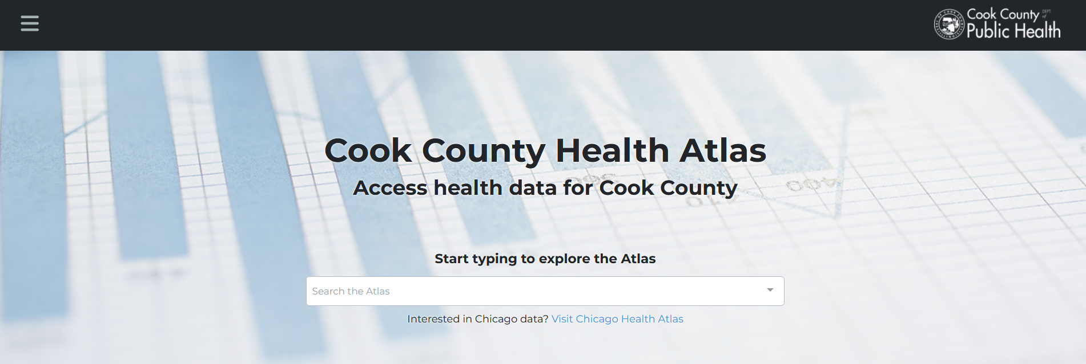
1
2
3
CHOOSE AN ACTIVITY THEME
HEALTH OUTCOMES
DEMOGRAPHICS
SOCIAL DETERMINANTS
Explore community patterns of disease and mortality
Explore neighborhood population characteristics including age, race and ethnicity
Explore indicators of food access and social vulnerability

Slide 7



CO-DESIGNING PUBLIC HEALTH DATA ACCESS & AWARENESS
CCDPH aims to work with VeggieRx to co-design the platform to improve its functionality and usability
(e.g., adding and enriching datasets, tools and documentation)
What did you find interesting with the health atlas?
What did you find confusing about the health atlas?
What types of data or tools could inform VeggieRx programs?
How could CCDPH’s Epi Unit further assist VeggieRx with the atlas?
Notes:
1. interesting?

Slide 8

NEXT STEPS
Identify potential uses &
enhancements
1
Work together to identify ways in which VeggieRx could use and/or improve the health atlas.
2
Implement changes
If needed, upload, edit and/or enhance datasets, tools and documentation on the platform.
3
Formalize use cases
Develop strategies and/or workflows to help VeggieRx utilize enhancements to the health atlas.

Slide 9
Appendix

Slide 10
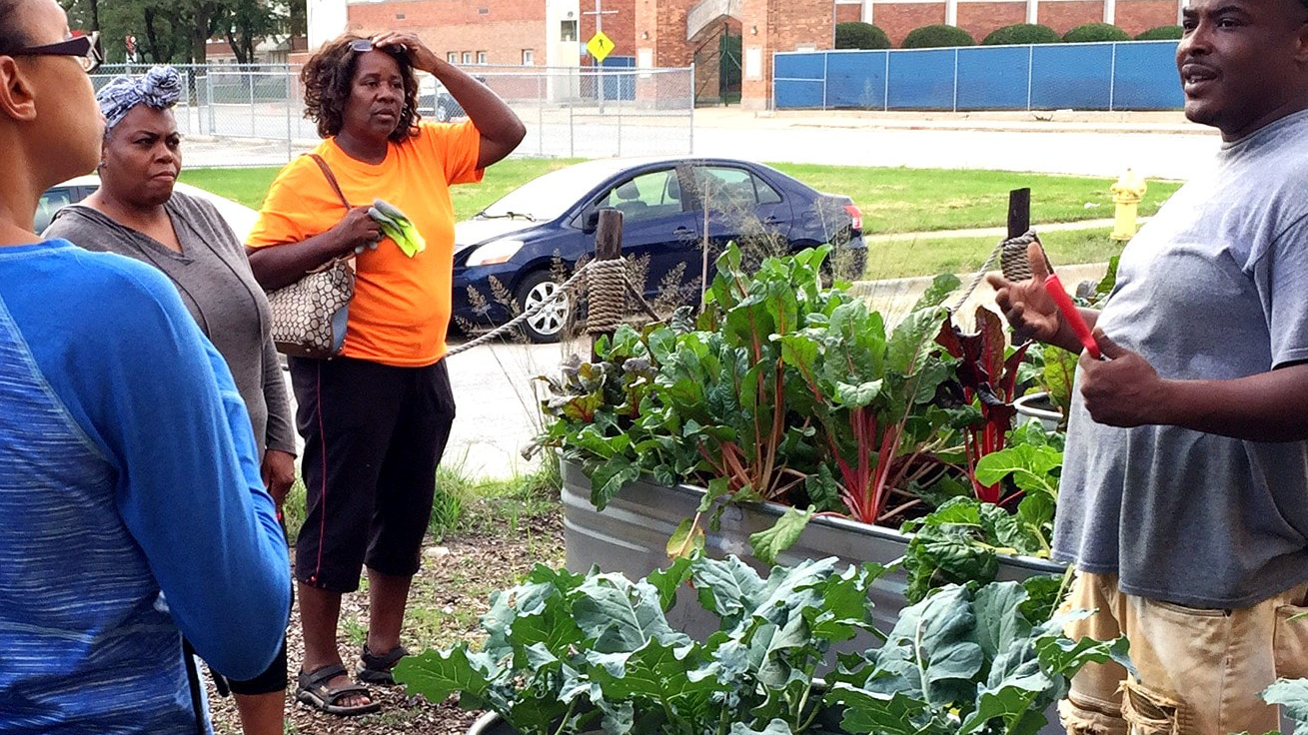
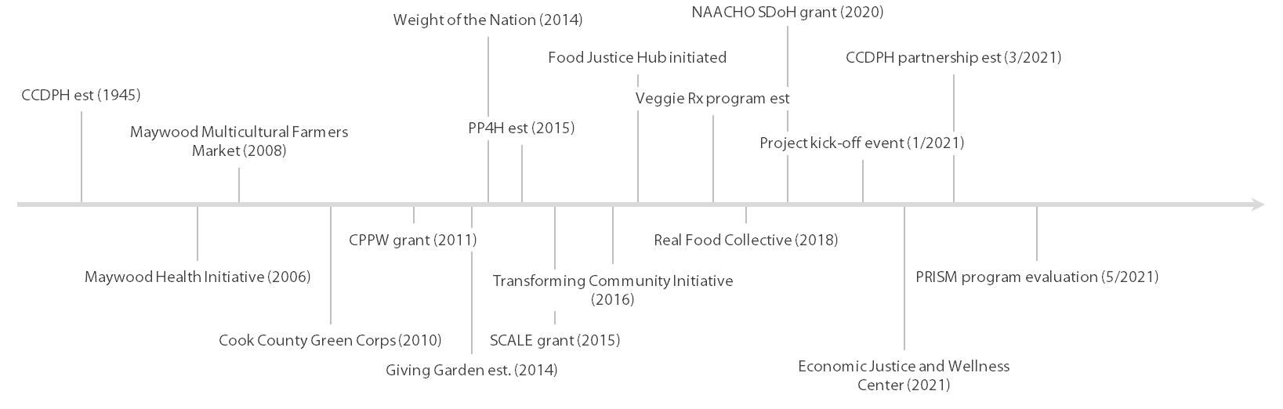
PROJECT BACKGROUND
Leveraging assets on a local scale
Leveraging assets on a national scale
Notes:
Should we update?

Slide 11
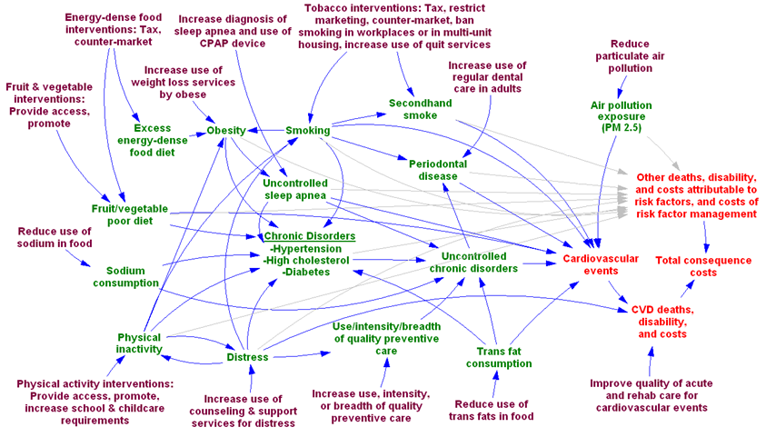
PRISM FRAMEWORK
Source: Adapted from Yarnoff, Benjamin. 2021. “Validation of the Prevention Impacts Simulation Model (PRISM).” Preventing Chronic Disease 18.
Notes:
Mapping the movement between intervention and impact
Touching the lives of individuals
Understanding impact is important
Source: Yarnoff, Benjamin. 2021. “Validation of the Prevention Impacts Simulation Model (PRISM).” Preventing Chronic Disease 18. https://doi.org/10.5888/pcd18.200225.

